Slide 1



Final Presentation
MARKETING STRATEGY FOR
ASTRALLYTECH
PRESENTED BY
GUIDED BY
Mr. Dhimant Korant
Co-Founder & CEO
AstrallyTech
Team TechSurfers
Lalit Madhav Viyyapu - lxv230008
Gampa Sai Shiva - sxg220333
Jiapeng Cao - jxc180070
Subramanian Ramesh Akshay - axs230128
Grandhi Sai Snehal - sxg230071

Slide 2
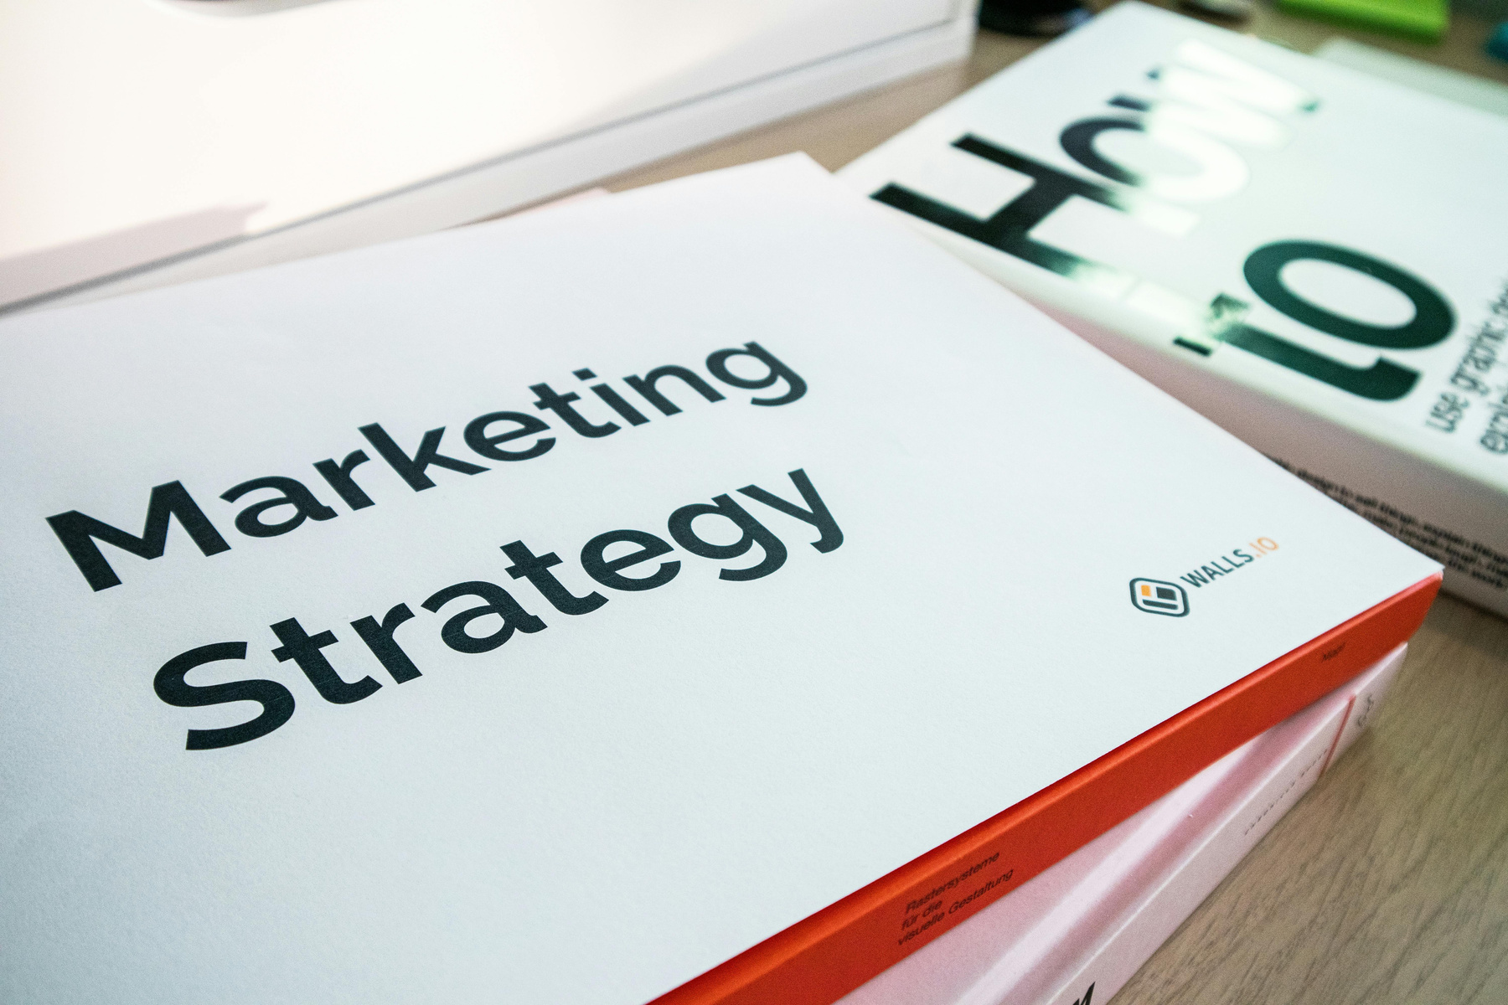

Midterm Project Summary
Executive Summary
Designed a comprehensive AI-based marketing strategy targeting StartUps & SMBs.
Goal: Enhance brand visibility through personalized, data-driven engagement.
Target Audience
Startups & SMBs in need of IT consulting for data management &IT infrastructure.​
HR & Hiring Managers seeking technology staffing solutions.​
Project Managers & Small Business Owners requiring project management tools.​
Local Businesses & SMEs looking for SMS marketing solutions.

Slide 3

Midterm Project Summary
Marketing Strategies
Brand Messaging
Digital Campaigns: Paid ads, SEO, content marketing.
Influencer Outreach: Creators across Social Media Platforms.
Email & Retargeting.
Values: Innovation, trust, simplicity.
Tagline: “Smart Connections, Real Results.”
Marketing Channels
Marketing Goals
Social Media, Google Ads, Email, Website Blog.
Tools for predictive analysis and A/B testing.
Increase brand awareness by 30% in 3 months.
Drive 15% increase in user engagement through AI automation.

Slide 4
Budget & Implementation Timeline
Budget Overview
General Allocation
SMBs allocate 7–8% of annual revenue to marketing.
B2C firms: 5–10% (up to 15%); B2B firms: ~5%.
Monthly Marketing Spend
Typical range: $2,500 – $12,000 for small to mid-sized businesses.
Covers SEO, PPC, social media, email marketing, content creation.
Implementation Roadmap
Launch and Awareness
(Jun - Aug 2025)
Lead Generation & Engagement
(Aug – Oct 2025)
Expansion & Optimization
(Oct – Dec 2025)
Scaling & Market Leadership
(Dec – Feb 2026)
Finalize branding, launch SEO site, run LinkedIn/Google Ads, begin content rollout
Email campaigns, webinars, drip campaigns, influencer partnerships
Retargeting, PPC/SEM optimization, boost interactivity, strengthen referrals
Use analytics, explore new markets, gather feedback, plan 2026 strategy
4

Slide 5

Performance Measurement & Optimization​
Validating Astrally’s marketing strategy and refining it using real-time data to ensure it's measurable, scalable, and adaptable.

Slide 6
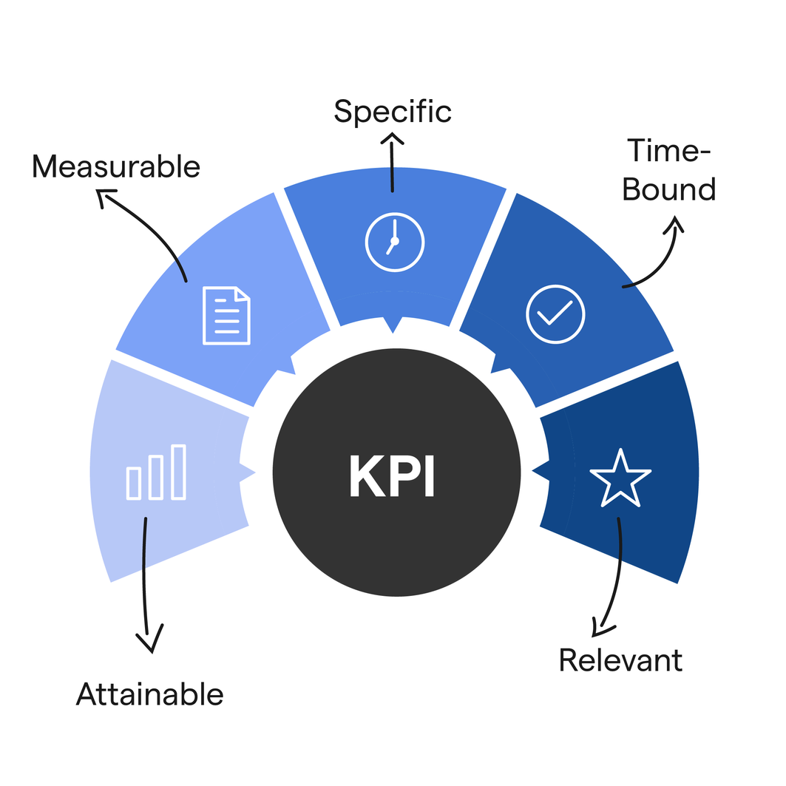
Performance Measurement & Optimization​
Key Performance Indicators
KPIs are metrics that help evaluate success across all marketing channels.Astrally’s KPIs should be SMART (Specific, Measurable, Achievable, Relevant,Time-bound).
Website Visitors: Total monthly users (tracked via Google Analytics).
Conversion Rate: Visitors converting to leads: (Leads / Visitors) * 100.
Cost per Lead: Marketing spend / leads.
Email Open & Click Rates: Measured from email platforms.
Return on Ad Spend (ROAS): Revenue per dollar spent on ads.
Social Media Engagement: Includes likes, shares, comments, and reach.

Slide 7

Performance Measurement & Optimization​
Marketing ROI Framework​
Formula:
Marketing ROI = (Revenue from Campaign - Marketing Cost) /Marketing Cost × 100
​
Advanced attribution models such as first-touch, last-touch, and time-decay can be used to assign creditacross the marketing funnel for amore accurate ROI.​

Slide 8
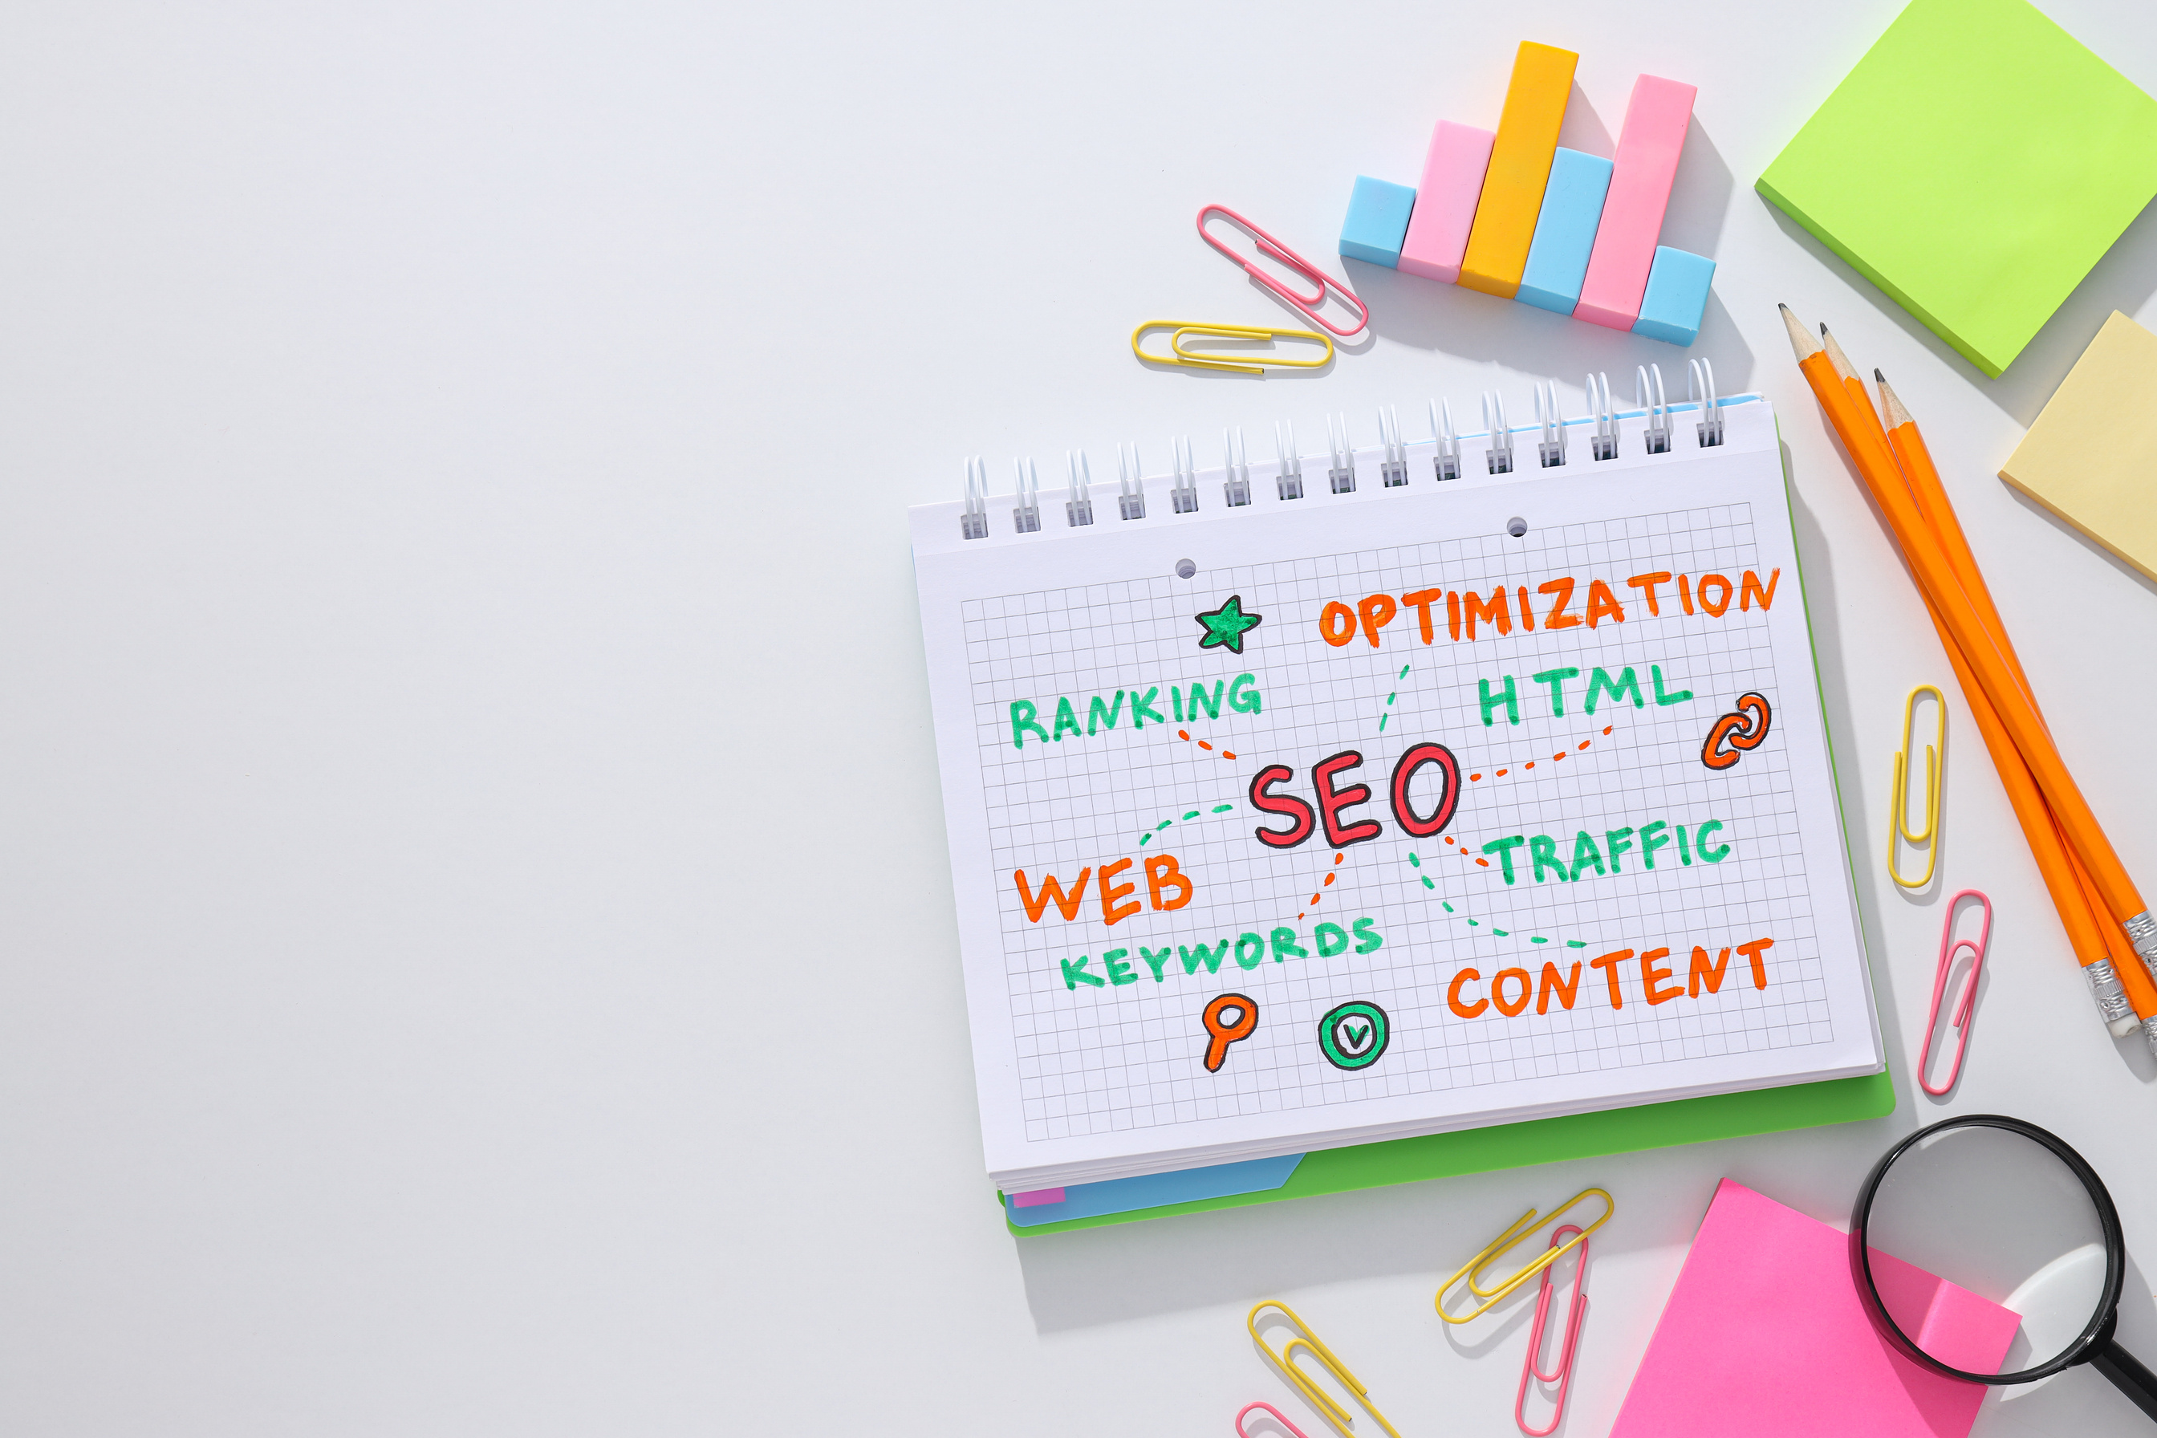
Performance Measurement & Optimization​
Recommendations for Optimization & Scaling​
• A/B Testing – Run experiments on ads, emails, and landing pages.​
• Budget Reallocation – Focus on high-performing channels and pause low-performing ones.​
• SEO Improvements – Improve keywords, site speed, and metadata.​
• Content Strategy – Refresh underperforming blogs and scale high-value assets.​
• Audience Refinement – Use analytics data to improve targeting.​
• Automation – Implement tools for email workflows and ad scheduling.

Slide 9
Performance Measurement & Optimization​
Monthly Marketing Dashboard Summary​
Month-by-month breakdown of Astrally’s marketing performance metrics.

Slide 10
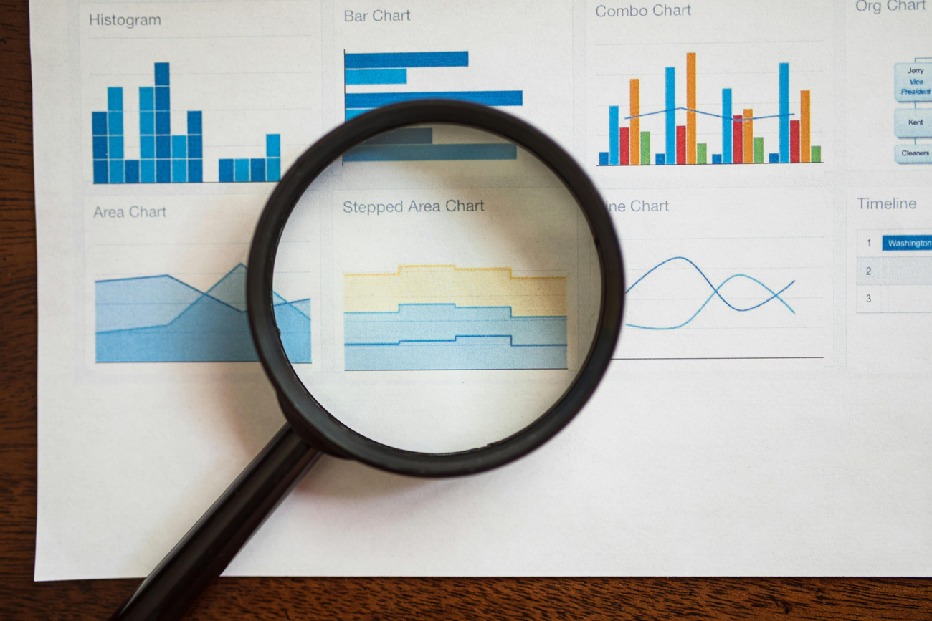
Performance Measurement & Optimization​
Website traffic steadily increased from 1,200 in June to 3,200 in December.​
Insights & Recommendations
Lead generation improved in proportion, maintaining an average conversion rate of 6.7%.​
Email open rates rose to 26%, indicating successful subject line and audience targeting.​
Cost per lead dropped from $30 to $23, indicating improved ad efficiency.​
ROAS increased from 3.2 to 4.3, showing greater profitability in ad spend.

Slide 11
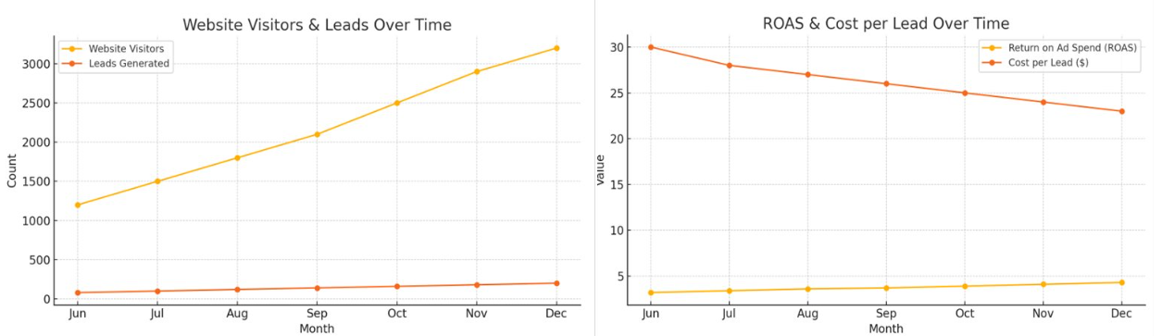
Performance Measurement & Optimization​
Visual Performance Charts​

Slide 12
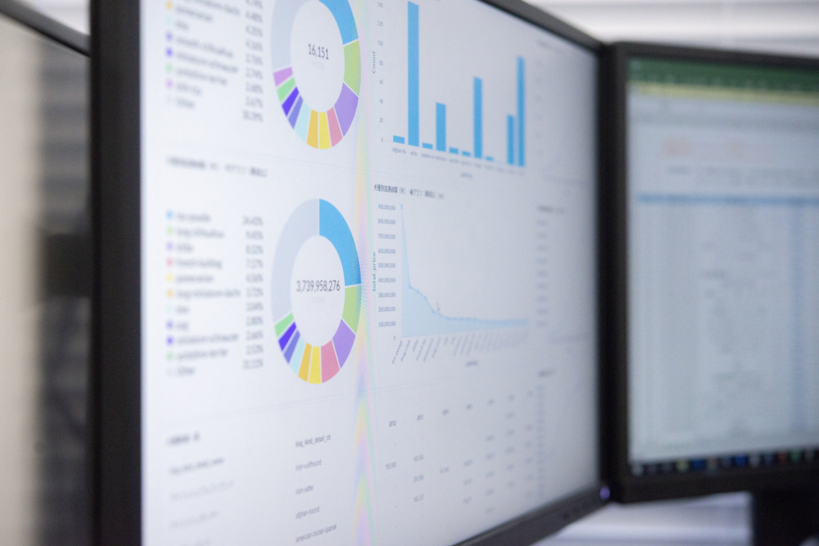

Performance Measurement & Optimization​
Metric Calculations​
Website Visitors: No formula — Tracked via Google Analytics as total sessions.​
Leads Generated: No formula — Count of leads captured via forms or CRM.​
Conversion Rate (%): Conversion Rate = (Leads Generated / Website Visitors) * 100​
Email Open Rate (%): Open Rate = (Emails Opened / Emails Sent) * 100​
Click-Through Rate (CTR): CTR = (Ad Clicks / Ad Impressions) * 100​
Cost per Lead (USD): Cost per Lead = Total Ad Spend / Leads Generated​
Return on Ad Spend (ROAS): ROAS = Revenue from Ads / Total Ad Spend

Slide 13






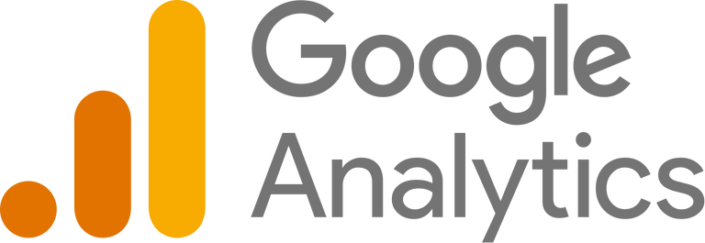


Recommendations for Optimization & Scaling​
A/B Testing: Google Optimize, Optimizely, VWO​
Ad Budget Reallocation: Google Ads, LinkedIn Campaign Manager, Meta AdsManager​
SEO Improvements: SEMrush, Ahrefs, Google Search Console​
Content Strategy Enhancement: BuzzSumo, Grammarly, Clearscope​
Audience Refinement / Targeting: Meta Audience Insights, LinkedIn Ads Targeting,Google Analytics Audiences​
Retargeting Campaigns: Google Ads Remarketing, Facebook Pixel, AdRoll​
Email & Ad Automation: HubSpot Marketing Hub, Mailchimp, ActiveCampaign​
Analytics & Performance Tracking: Google Analytics 4 (GA4), Looker Studio,Mixpanel​
Lead Scoring / CRM: Zoho CRM, Salesforce, HubSpot CRM
4

Slide 14



Tools for Social Media Engagement
:​
Why It's Great: Schedule posts, monitor engagement, and respond across multiple platforms.​
Use Case Fit: Best for managing LinkedIn, Instagram, and Twitter in one place.
​
Why It's Great: Easy post scheduling, analytics, and collaboration features.​
Use Case Fit: Ideal for analyzing B2B content performance with a lean team.
​
Why It's Great: Advanced analytics, smart inbox for all DMs, and audience insights.​
Use Case Fit: Great for tracking engagement and making data-driven decisions.​
4

Slide 15
LinkedIn Performance Metrics (Jun to Dec)

Slide 16
References
SMB Marketing Budget: https://www.webfx.com/industries/general/small-businesses/marketing-budget/
B2B vs. B2C Allocation: https://www.bdc.ca/en/articles-tools/marketing-sales-export/marketing/what-average-marketing-budget-for-small-business
Monthly Spend Range: https://succeedingsmall.co/small-business-marketing-budget/
Essential Digital Marketing KPIs: https://landingi.com/digital-marketing/kpis/
Email Marketing Metrics: https://www.mailercheck.com/articles/email-marketing-kpis
A/B Testing Tools: https://vwo.com/tools/
SEO Tools: https://zapier.com/blog/best-seo-tools/
Content Strategy: https://www.verblio.com/blog/seo-driven-content-strategy
Audience Targeting: https://www.facebook.com/business/insights/tools/audience-insights
Retargeting Campaigns: https://www.adroll.com/blog/google-remarketing-vs-facebook-retargeting-which-should-you-choose
Email & Ad Automation: https://www.emailtooltester.com/en/blog/email-automation-software/
Analytics & Performance Tracking: https://mixpanel.com/blog/mixpanel-marketing-analytics-vs-google-analytics/
CRM & Lead Scoring: https://blog.exactbuyer.com/post/lead-scoring-model-software-for-effective-lead-management
Social Media Engagement: https://www.techradar.com/best/best-content-marketing-tools

Slide 17
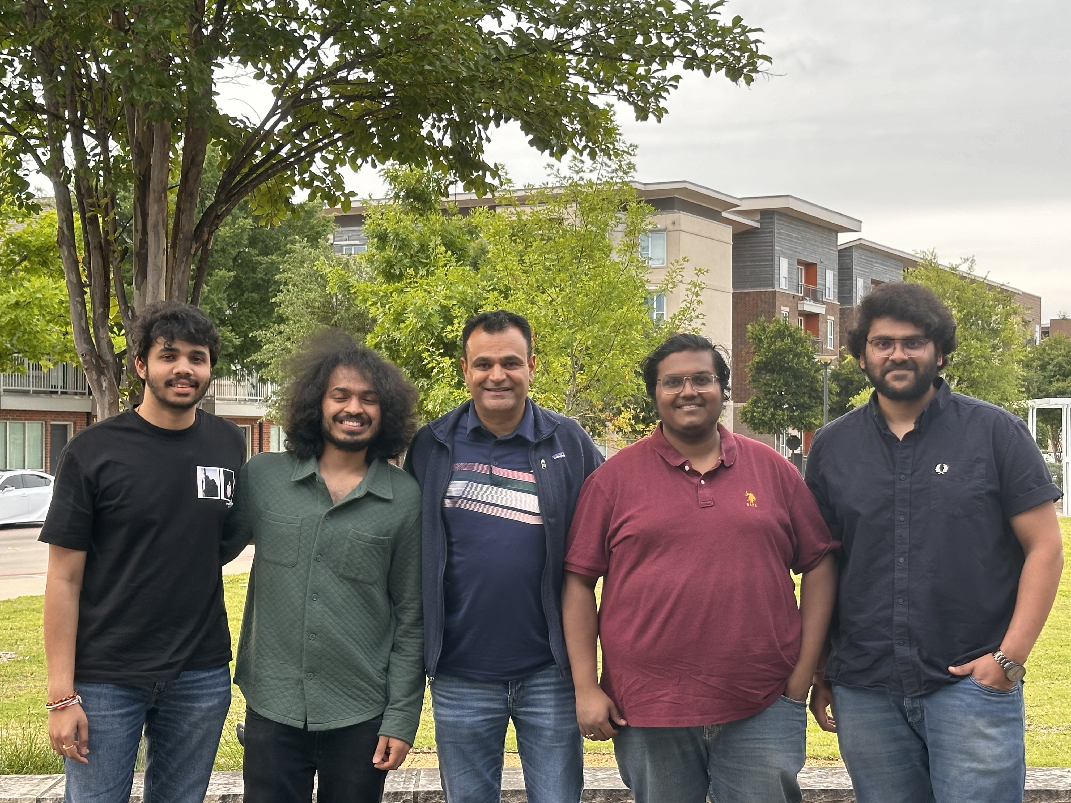
THANK YOU

Slide 18


